Slide 1

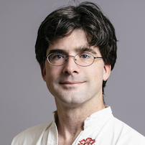

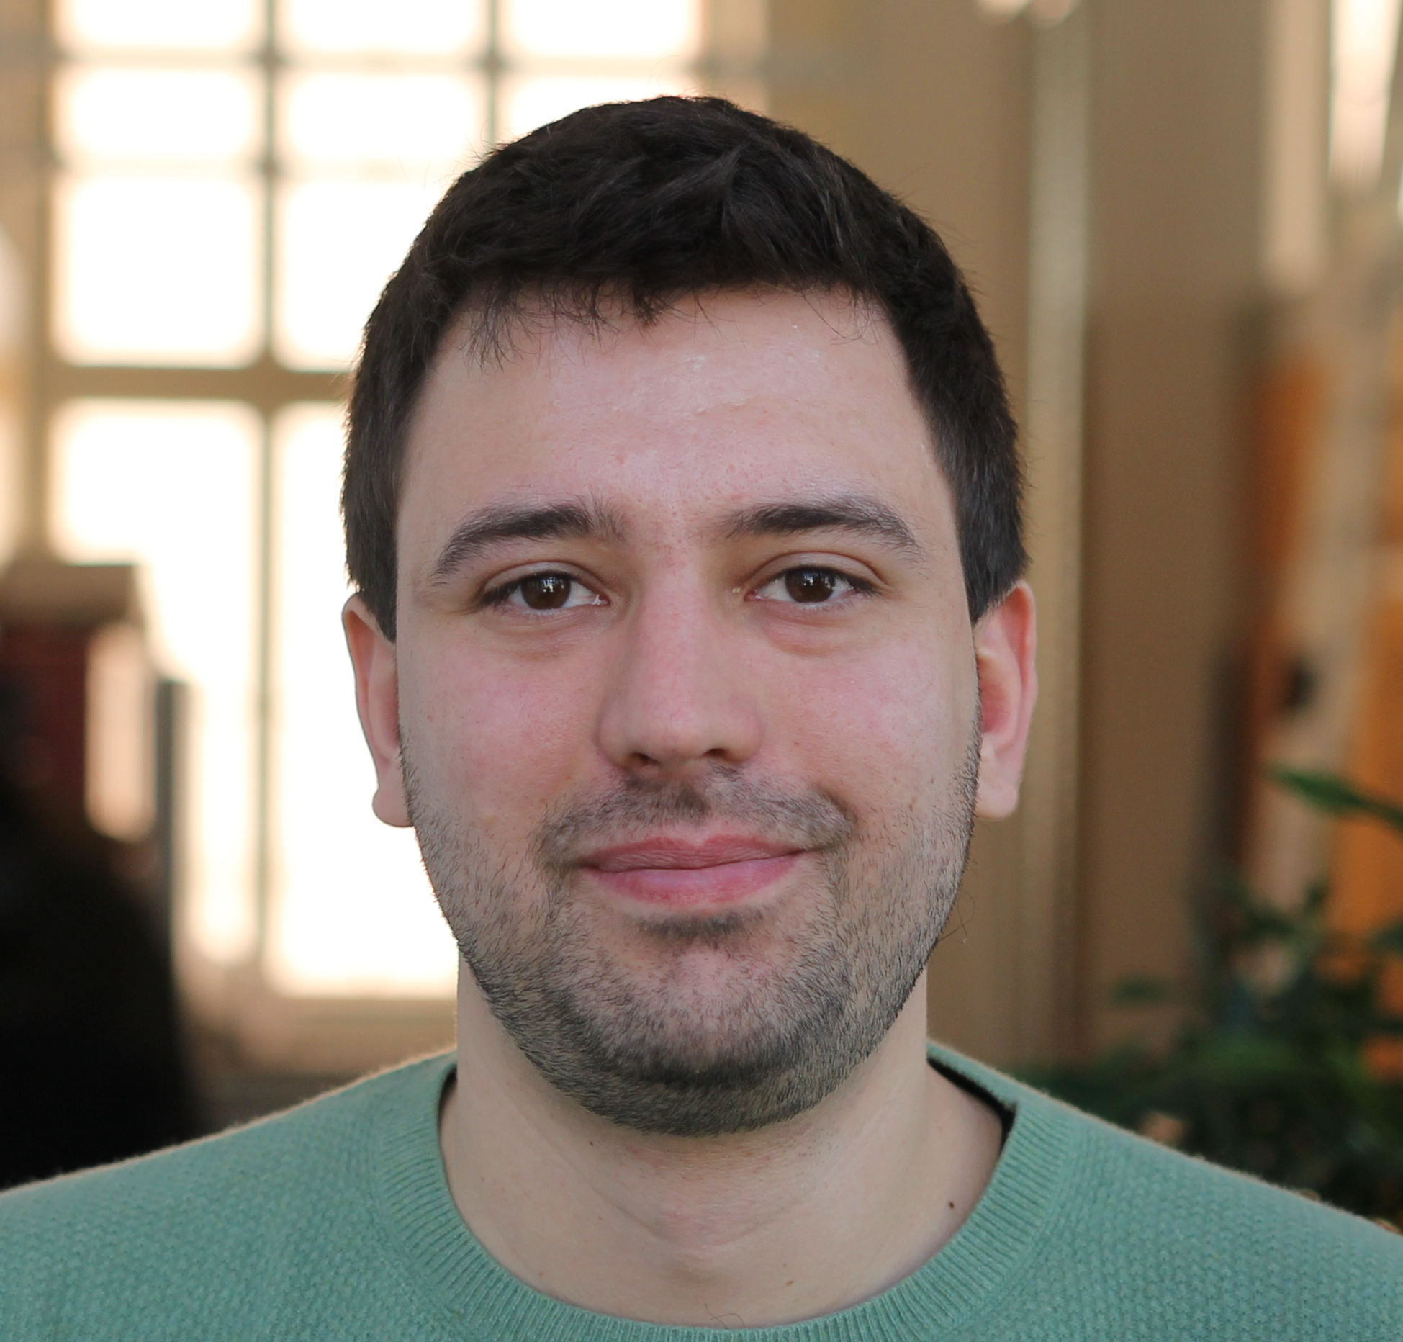


veribetrfs
verification as a practical engineering tool
Travis Hance CMU
Jon Howell VMware
Rob Johnson VMware
Andrea Lattuada ETHZ
Bryan Parno CMU

Slide 2
is (always) hiring!

Slide 3
Why now?
software verification: decades “in the lab”; small examples
2009 first big verified system: seL4
improvements in automation tooling

Slide 4
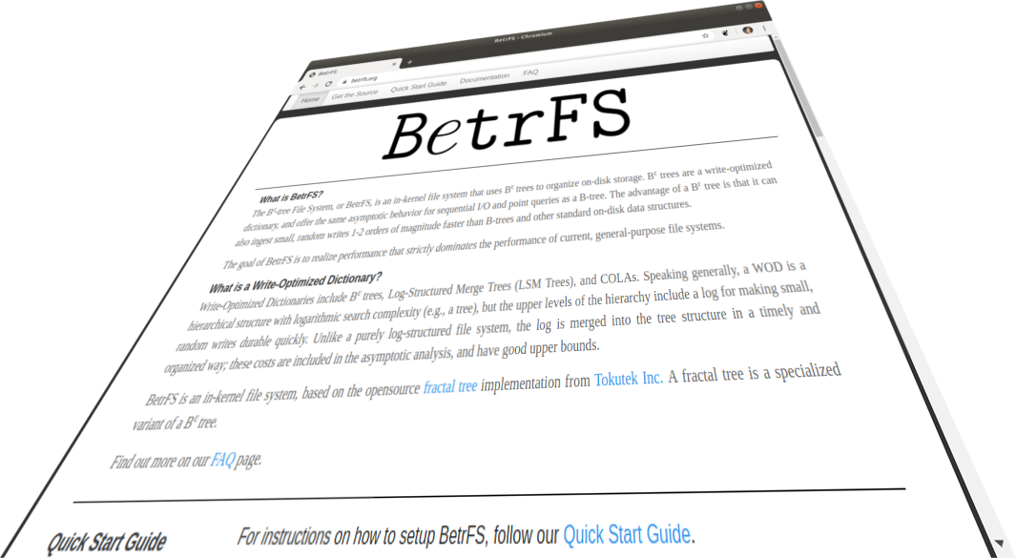
can verification displace testing?
Test hypothesis by “using verification in anger”
We actually want the resulting system
We need to build & maintain the artifact
Push boundaries in verification:
Performance
Maintainability
Accessibility

Slide 5
Testing and specification
Verification challenges & Iron★ solutions
Evaluation preview

Slide 6
Testing and specification
Verification challenges & Iron★ solutions
Evaluation preview

Slide 7
Test-Driven Development: tests are the specification

Slide 8
$
latent
bugs
anecdotally: 1-2X
open source average: 0.05X
open source max: 12X
SQLite: 662X

Slide 9
Verification is exhaustive testing

Slide 10
Verification as alternative testing
 | Testing | Verification
Latent bugs cost | many | very few
Specification code size | >50% | <10%
Up-front cost | variable | significant
Notes:
Highlight benefits
Discuss challenges of specification
Emphasize that up-front cost (proof) is the big challenge

Slide 11
Testing and specification
Verification challenges & Iron★ solutions
Evaluation preview

Slide 12
Verification Challenge | Iron★ Solution
Writing a concise, meaningful spec | TLA+ state machines
Organizing proof “code” | Refinement over functional models
Tedious proofs | Dafny/Z3 automation, bisection debugging
Brittle heap reasoning | Impl-Model mates, borrow-typing

Slide 13
Verification Challenge | Iron★ Solution
Writing a concise, meaningful spec | TLA+ state machines
Organizing proof “code” | Refinement over functional models
Tedious proofs | Dafny/Z3 automation, bisection debugging
Brittle heap reasoning | Impl-Model mates, borrow-typing

Slide 14
Concise Specification: shortest path
predicate IsPath(g, p, begin, end) {
&& p[0] == begin
&& Last(p) == end
&& forall i :: 0 <= i < |p|-1 ==> Edge(p[i], p[i+1]) in g.edges
}
predicate IsShortestPath(g, p, begin, end) {
&& IsPath(g, p, begin, end)
&& forall p2 :: IsPath(g, p2, begin, end) ==> Len(p) <= Len(p2)
}

Slide 15
Concise Specification of behaviors: KV store
datatype Variables = Variables(view:map<K,V>)
predicate Query(key:Key, result:Value) { && result == s.view[key] && s' == s }
predicate Write(key:Key, new_value:Value) { && s'.view == s.view[key := new_value] }
predicate Init() { s.view == EmptyMap() }
predicate Next() { || (exists k, r :: Query(k, r)) || (exists k, v :: Write(k, v)) }
Notes:
This is quite close to the specification of our key-value store.
There’s code to specify range queries, and specification to define crash semantics.

Slide 16





cat←2
cat←3
dog←2
cat=3
pig←6
cat←2
cat←3
{flush}
dog←2
{crash}

Slide 17
Verification Challenge | Iron★ Solution
Writing a concise, meaningful spec | TLA+ state machines
Organizing proof “code” | Refinement over functional models
Tedious proofs | Dafny/Z3 automation, bisection debugging
Brittle heap reasoning | Impl-Model mates, borrow-typing

Slide 18
Verification Challenge | Iron★ Solution
Writing a concise, meaningful spec | TLA+ state machines
Organizing proof “code” | Refinement over functional models
Tedious proofs | Dafny/Z3 automation, bisection debugging
Brittle heap reasoning | Impl-Model mates, borrow-typing

Slide 19
Node node = new Node(config.alloc_size);
node->insert_items(keys, values);
LBA lba = find_free_lba();
mumble();
node->schedule_write(lba, callback);

Slide 20
The Proof Artifact
Correctness is argued at multiple levels of abstraction
Verification requires an explicit argument (proof)
Engineers maintain the code and the proof

Slide 21
B^{ε}tree
A-I J-R S-Z
cat←7
tim←2
yak←7
A-C D-F G-I
S-U V-X Y-Z
tim←1
zoe←3
cat←6
dog←1
J-L M-O P-R
kid←0
pig←1

Slide 22
Refinement
spec
map
crash-safe map
proof
B^{ε}tree
(∞ nodes)
Block Cache
crash-safe tree
B^{ε}tree
(pivot nodes)
B^{ε}tree
(marshallable)
implementation
B^{ε}tree Impl
(uint64, mutable)
Block Cache Impl

Slide 23
Anatomy of a proof
Refinement
each B^{ε}tree step is a map step
map
Interpretation
B^{ε}tree transformations preserve all lookups
B^{ε}tree
(∞ nodes)
Invariant
B^{ε}tree children obey pivots
Separation
node heap representations are disjoint
B^{ε}tree Impl
(uint64, mutable)

Slide 24
Verification Challenge | Iron★ Solution
Writing a concise, meaningful spec | TLA+ state machines
Organizing proof “code” | Refinement over functional models
Tedious proofs | Dafny/Z3 automation, bisection debugging
Brittle heap reasoning | Impl-Model mates, borrow-typing

Slide 25
Verification Challenge | Iron★ Solution
Writing a concise, meaningful spec | TLA+ state machines
Organizing proof “code” | Refinement over functional models
Tedious proofs | Dafny/Z3 automation, bisection debugging
Brittle heap reasoning | Impl-Model mates, borrow-typing

Slide 26

a big system is a tree of definitions.
at the bottom of the tree is first-order logic.
is great at solving huge logic problems!
...but which definitions do you show it?

Slide 27



✓
VALID
✓
is
theorem
correct?
INVALID
JUST RIGHT
EVERY
open
which
definitions?
too
many
definitions?
system definitions
HEURISTICS
NONE
TOO MANY
hourglass: Dub @ wikimedia commons. Boulder guy: jalandas0 @ pixabay

Slide 28
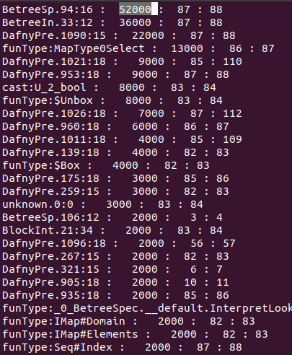
A day in the life of a verification programmer
lemma NodeIsWellFormed(c:Children, n: Node)
requires n == ConstructNode(c)
ensures WellFormed(n)
{
}
assert Sorted(n.children);
hourglas: Dub @ wikimedia commons

Slide 29
Verification Challenge | Iron★ Solution
Writing a concise, meaningful spec | TLA+ state machines
Organizing proof “code” | Refinement over functional models
Tedious proofs | Dafny/Z3 automation, bisection debugging
Brittle heap reasoning | Impl-Model mates, borrow-typing

Slide 30
Verification Challenge | Iron★ Solution
Writing a concise, meaningful spec | TLA+ state machines
Organizing proof “code” | Refinement over functional models
Tedious proofs | Dafny/Z3 automation, bisection debugging
Brittle heap reasoning | Impl-Model mates, borrow-typing

Slide 31
Aliasing Control
method foo() {
n1 := MakeNode(parent);
i := this.FindIndex(key);
this.UpdateWeights();
this.ReplaceChild(i, n1);
}
ObeysPivots(n1)
IndexForKey(key, i)

Slide 32
this.UpdateWeights();
this
n1
indices
weights
quadratic
disjoint
conditions
interferes
with bisection
debugging
ObeysPivots(n1)

Slide 33
Aliasing: Iron★ Model-Impl mates
proof
spec
map
crash-safe map
proof
B^{ε}tree
(∞ nodes)
Block Cache
crash-safe tree
B^{ε}tree
(pivot nodes)
B^{ε}tree
(marshallable)
assertion failures
point to functional
semantics
implementation
B^{ε}tree Model
(uint64)
B^{ε}tree Impl
(uint64, mutable)
HashTbl
<immutable_seq>
assertion failures
point to aliasing
implementation
B^{ε}tree Impl
(mutable)
HashTbl <mutable_array>

Slide 34

Aliasing: Rust-y linear types
Exclude aliases at static typecheck time
Less expressive (hence Rust’s unsafe): 90/10 rule
Reduces tedium

Slide 35
Testing and specification
Verification challenges & Iron★ solutions
Evaluation preview

Slide 36
Evaluation
Can we build a big system?
Can we build a fast system?

Slide 37
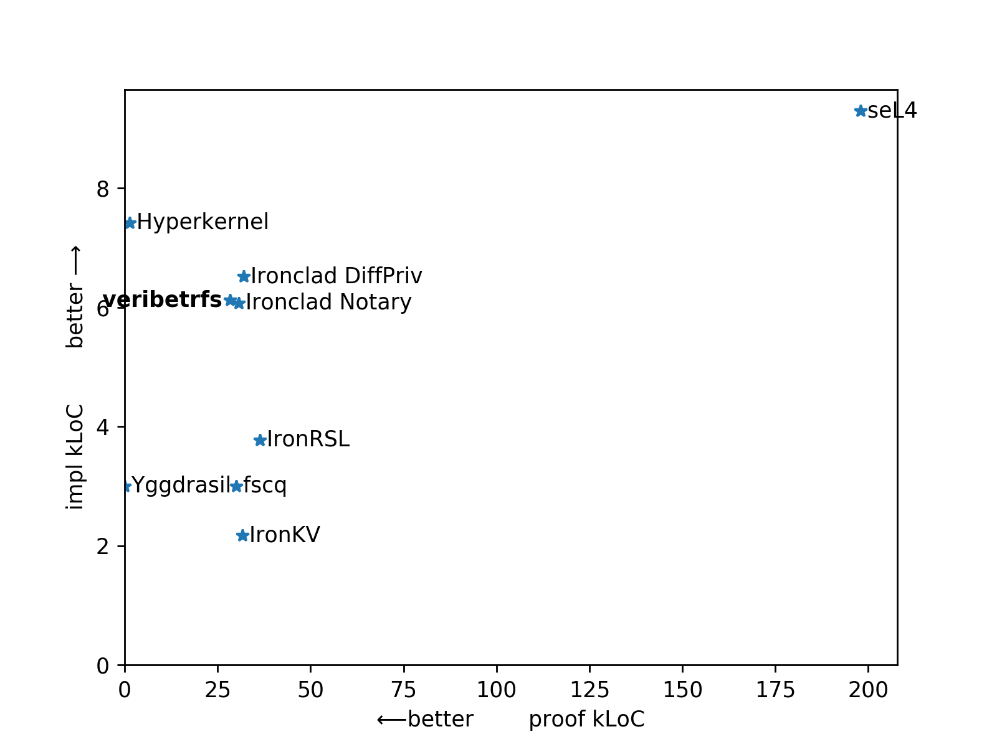

Slide 38


Performance?
benchmark | num ops | value size | sync rate | IO/sec
YCSB-A (50R/50W) | 1M | 512 | 1Hz | 63k
YCSB-B (95R/5W) | 5M | 512 | 1Hz | 111k
YCSB-C (100R) | 5M | 512 | 1Hz | 144k
YCSB-X (100W) | 5M | 512 | 1Hz | 32k
numbers from papers, varying CPUs, SSDs
Yggrasil | 10K | 1K | every file | 780
FSCQ | 10K | 1K | every file | 670
DFSCQ | 1K | 100 | every file | 300-1.7K
AtomFS | 10K | 1K | /dev/ram0 | 3.8K
IronKV | 1K | 128-8K | no persist | 9K-24K
Can we build fast systems?
Verification is compile-time!
High burden, limited impl frameworks→ most systems slow in practice
apple: applesnpearsau@flickr, orange: Evan-Amos@wikimedia
Notes:
Yggdrasil numops/value size came from LFS paper ‘small file’ benchmark (fig 8 caption)
Yggdrasil IOPS came from interpolating yggdrasil paper fig 6 to get 12.8s runtime, dividing into 10k ops.
FSCQ paper fig 19 gives 15s for “smallfile”. Again, assuming 10k/1k from LFS.
Yggdrasil fig 6. gives FSCQ matching Yxv6, at about 780.
AomFS Fig 10
IronKV Fig 14

Slide 40
backup

Slide 41
abstract
Recent progress in systems verification have shown that verification techniques can scale to thousands of lines. It is time to ask whether verification can displace testing as an effective path to software correctness.
The veribetrfs project is developing a verified high-performance storage system. A primary goal of the project is to reduce verification methodology to engineering practice. Veribetrfs is developed using the Iron★ methodology, a descendant of the Ironclad and IronFleet projects. So far, we have a key-value store with 100k iops performance and strong guarantees against data loss. This talk will give an overview of the methodology and describe how we have enhanced it in veribetrfs.

Slide 42
Dafny is a good fit for most-frequent tasks
Advice: Most reasoning should be about immutable (functional) mathematical objects
Experience: Most reasoning is first-order predicates, definition-opening tedium
Z3’s pretty good at that!
But how to exploit Z3?
By hand: TLAPS
By model: Ivy
By syntactic “triggers”: Dafny
Striking a balance between automation and runaway timeouts
Advice: default to automation, but aggressively detect and control timeouts
Notes:
Most of these proofs are reasoning about functional (immutable) mathematical objects.

Slide 43
A day in the life of a verification programmer
Write an obligation
Write an implementation (a lower-layer refinement or imperative method)
Use source-level bisection debugging to understand proof failure
Dafny can’t see your brilliance -- assertions act as triggers
Your invariant isn’t inductive
The implementation is wrong -- why we verify!
The obligation is wrong (bogus interpretation fcn)
React aggressively to timeouts
Advice: Keep it interactive. One function/lemma takes < 20s.
verification profiler identifies too-liberal triggers

Slide 44
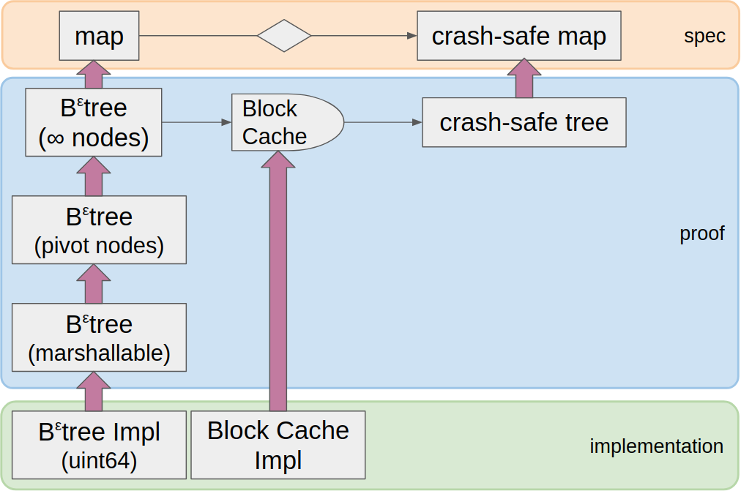
Most functional proof is tedium:
satisfying first-order logic
opening definitions
Dafny automates both.
via syntax heuristics
risking timeouts
Advice:
default to automation
aggressively handle timeouts
functional
mutable

